Slide 1
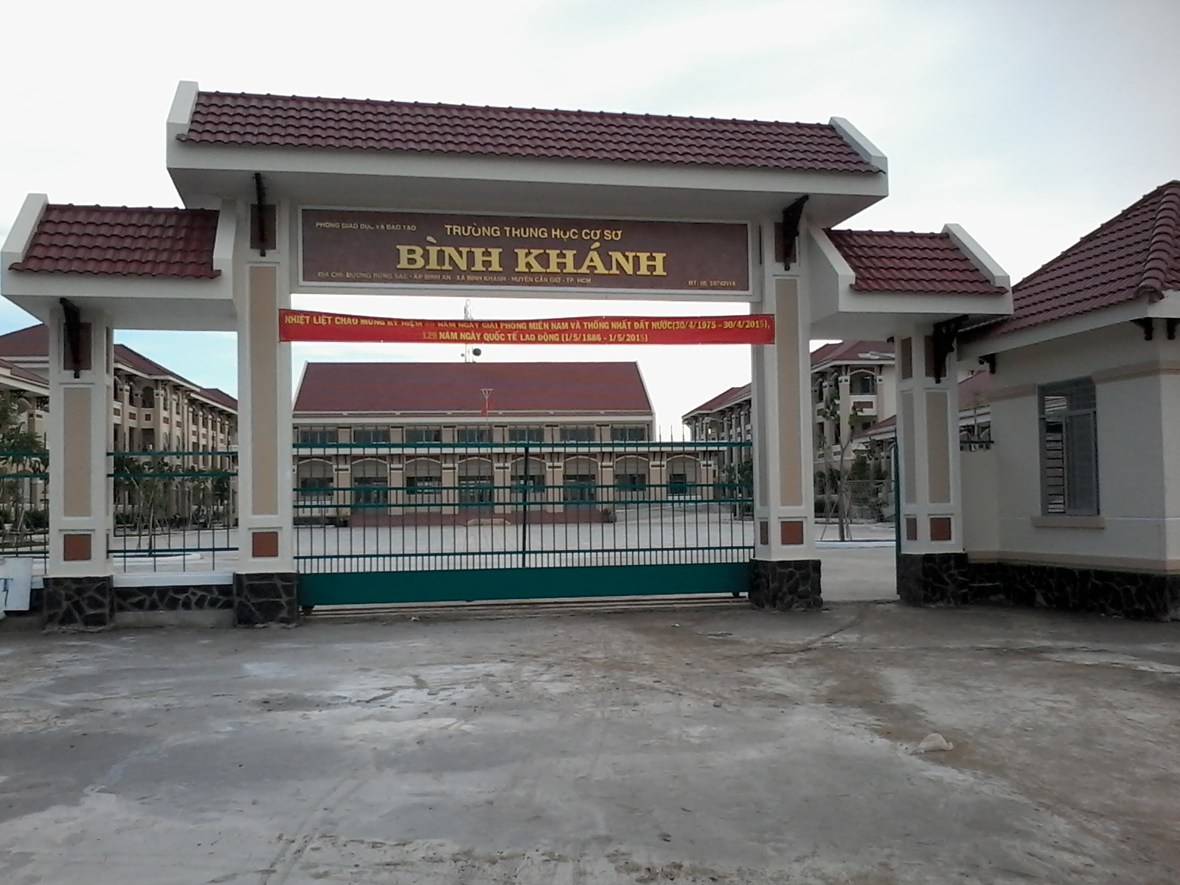
BINH KHANH SECONDARY SCHOOL
FRIENDS PLUS 6

Slide 2
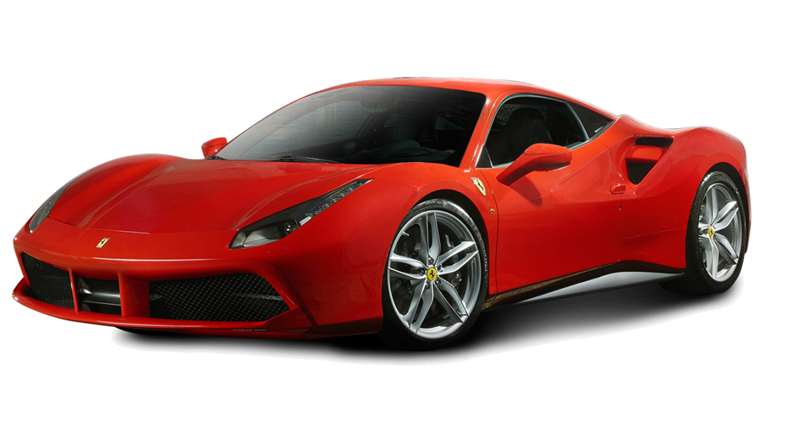
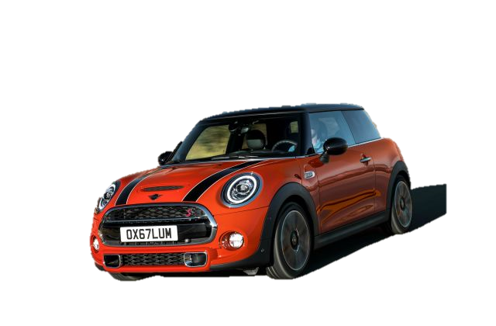
What's the difference
between them?

Slide 3
STARTER UNIT
Lesson 5
Vocabulary
Basic adjectives

Slide 4
What are adjectives?

Slide 5
1.This is a blue plate.
Adj
Noun
2.This mobile phone is expensive.
To be
Adj

Slide 6
Position of Adjective
after to be
before Noun
to be +Adj
Adj + noun

Slide 7
Exercise 1 – Matching
horrible
nice
old
slow
good
expensive
small
popular
interesting
new
fast
bad
cheap
big
unpopular
boring

Slide 8
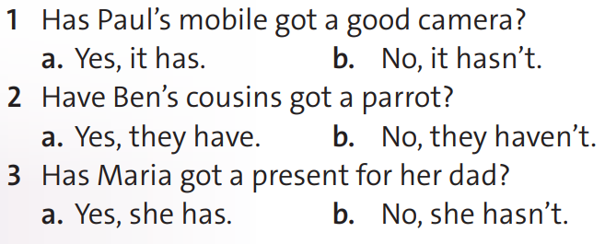
Exercise 2 – Reading

Slide 9
quite
Adverbs
of degree
very
really

Slide 10
Exercise 3 – Writing
Ex: 1. This film is quite boring.
2. My dad's laptop is very expensive.

Slide 12
- Learn by heart all the new words
- Prepare for next lesson – Language focus: This, That, These, Those, Have got

